Slide 1
CyberWebX
Ahmet Yigit - 200104004066
Emre Oytun - 200104004099
Elif Deniz - 210104004239
https://github.com/Mens1s/CyberWebX

Slide 2
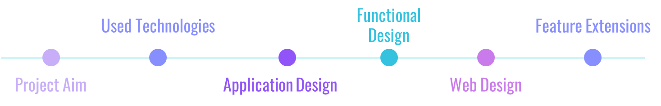
CONTENTS

Slide 3
Project Aim
01
02
03
04
05
06
Domain Check
Domain Information
PE Analysis
Instantly identify malicious or phishing domains using intelligent analysis.
Retrieve detailed domain insights and security indicators.
Quickly analyze executable files to detect malware through static header inspection.
Scraper Tool
Password Generator
OSINT Operations
Efficiently collect publicly available user data for security analysis.
Generate secure, personalized passwords based on user’s digital footprint.
Leverage Open-Source Intelligence techniques to enhance cybersecurity.

Slide 4
Used Technologies
Frontend
Backend
HTML & CSS: Responsive and clean user interfaces.
JavaScript (Vanilla JS): Simple yet dynamic front-end interactions
Python Flask: Lightweight REST API services.
Scikit-learn: Powerful machine learning framework.
Joblib: Efficient model serialization and deployment.

Slide 5
Used Technologies
Machine Learning & Analysis
OSINT & Utilities
Random Forest: Malware detection with header-based analysis.
Logistic Regression: Domain trust evaluation through URL analysis.
TF-IDF: Efficient text-based feature extraction.
Requests & BeautifulSoup: Public data extraction from web sources.
Tkinter: Standalone GUI for secure local OSINT operations.

Slide 6
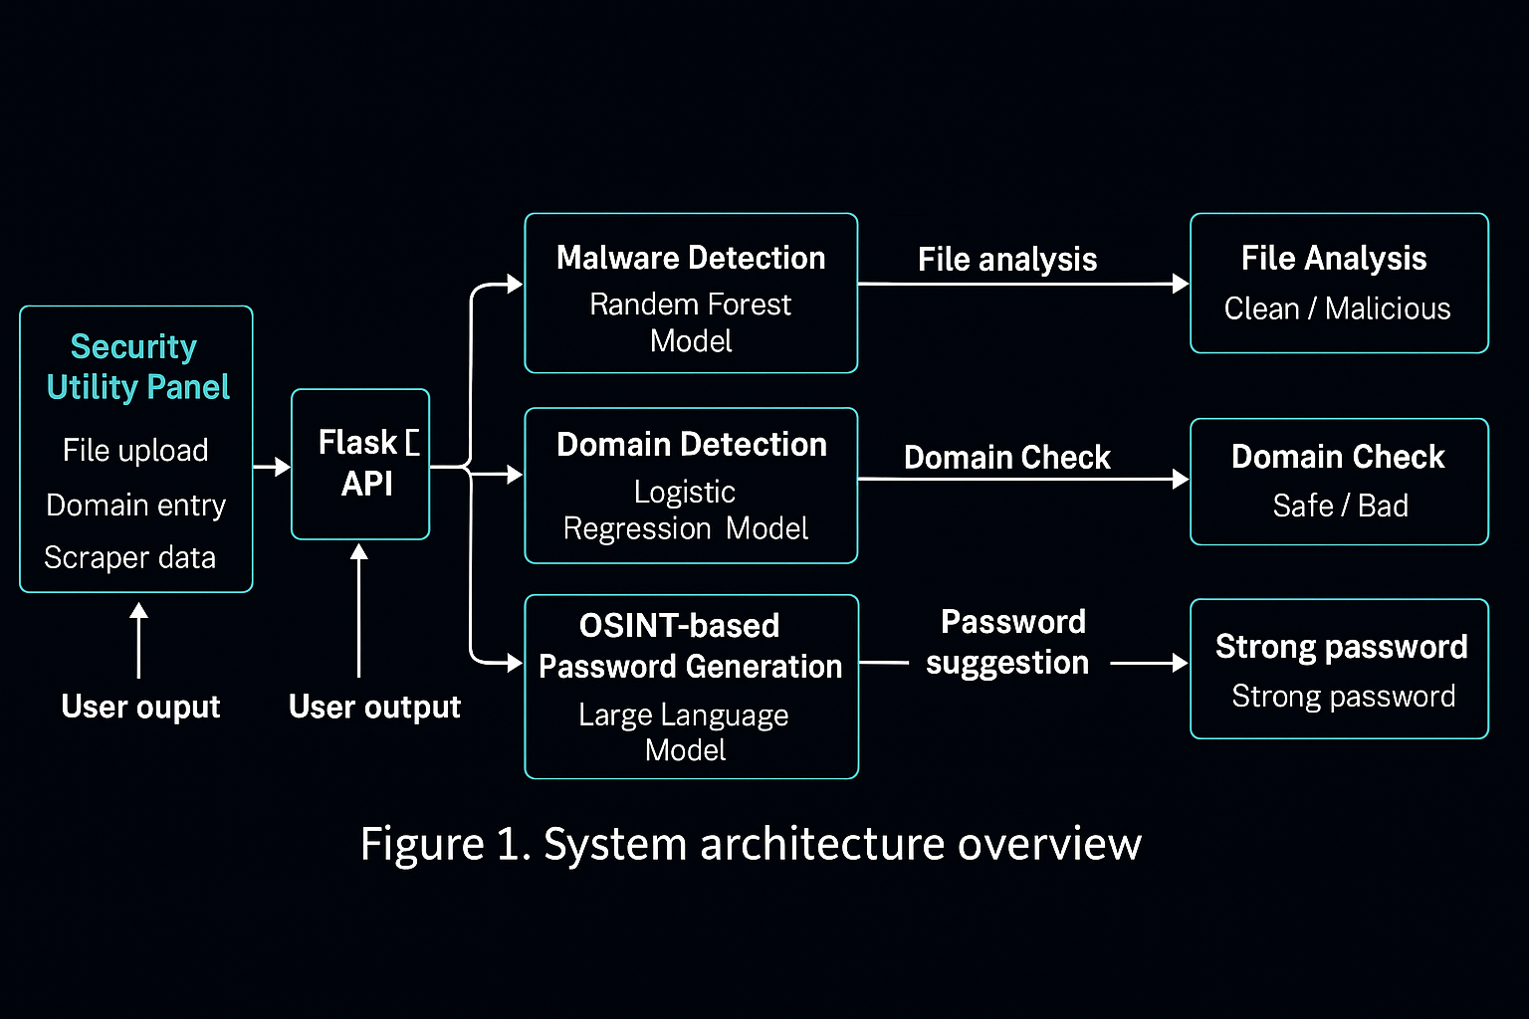
Application Diagram

Slide 7
Functional Design
Malware File Detection (PE Analysis)
Static header-based analysis without file execution.
Feature extraction (section count, entropy, timestamps).
Real-time binary malware classification using Random Forest.
Detailed analysis results presented clearly on user interface.
Domain Trust Detection (URL Analysis)
Tokenization and lexical feature extraction from URLs.
TF-IDF vectorization for effective text representation.
Logistic Regression-based phishing URL detection.
Whitelisting mechanism to reduce false positives.
Instant identification and reporting of suspicious domains.
Local GUI Application (Tkinter) - Scraper
Standalone application for secure local OSINT operations.
User-friendly interface for non-technical users.
Real-time feedback and progress indication during scraping.
It extracts txt file as output with collected informations.
Uses Selenium to scrape LinkedIn & Twitter profile data.
Uses Instaloader to extract Instagram profile details.
Combines multi-platform results into a unified report.

Slide 8
Machine Learning Methods
Logistic Regression - Domain
RandomForest - PE Analysis
Logistic Regression is a linear classification algorithm used to predict binary outcomes
It takes input features (in this case, text transformed by TF-IDF) and learns a linear decision boundary that separates the two classes.
Why?
It works very well for text classification problems.
It’s simple, fast, and efficient, especially when using sparse feature representations like TF-IDF.
It performs strongly on binary classification tasks with limited feature interactions.
Random Forest is an ensemble learning method that builds multiple decision trees and combines their outputs for a final prediction.
It handles tabular, numerical data by capturing complex feature interactions and reducing overfitting through randomization.
Why?
It is powerful for structured datasets with many numerical features.
It can automatically assess feature importance.
It handles complex, nonlinear patterns that simpler models (like Logistic Regression) can’t capture well.

Slide 9
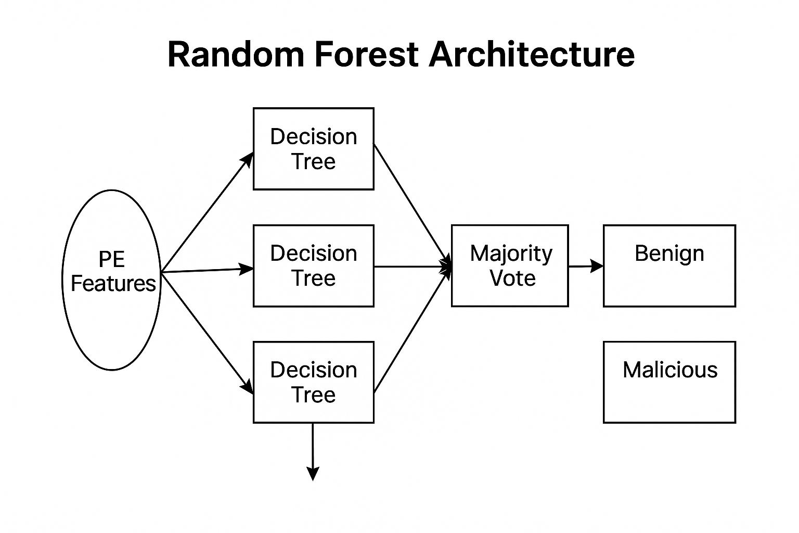
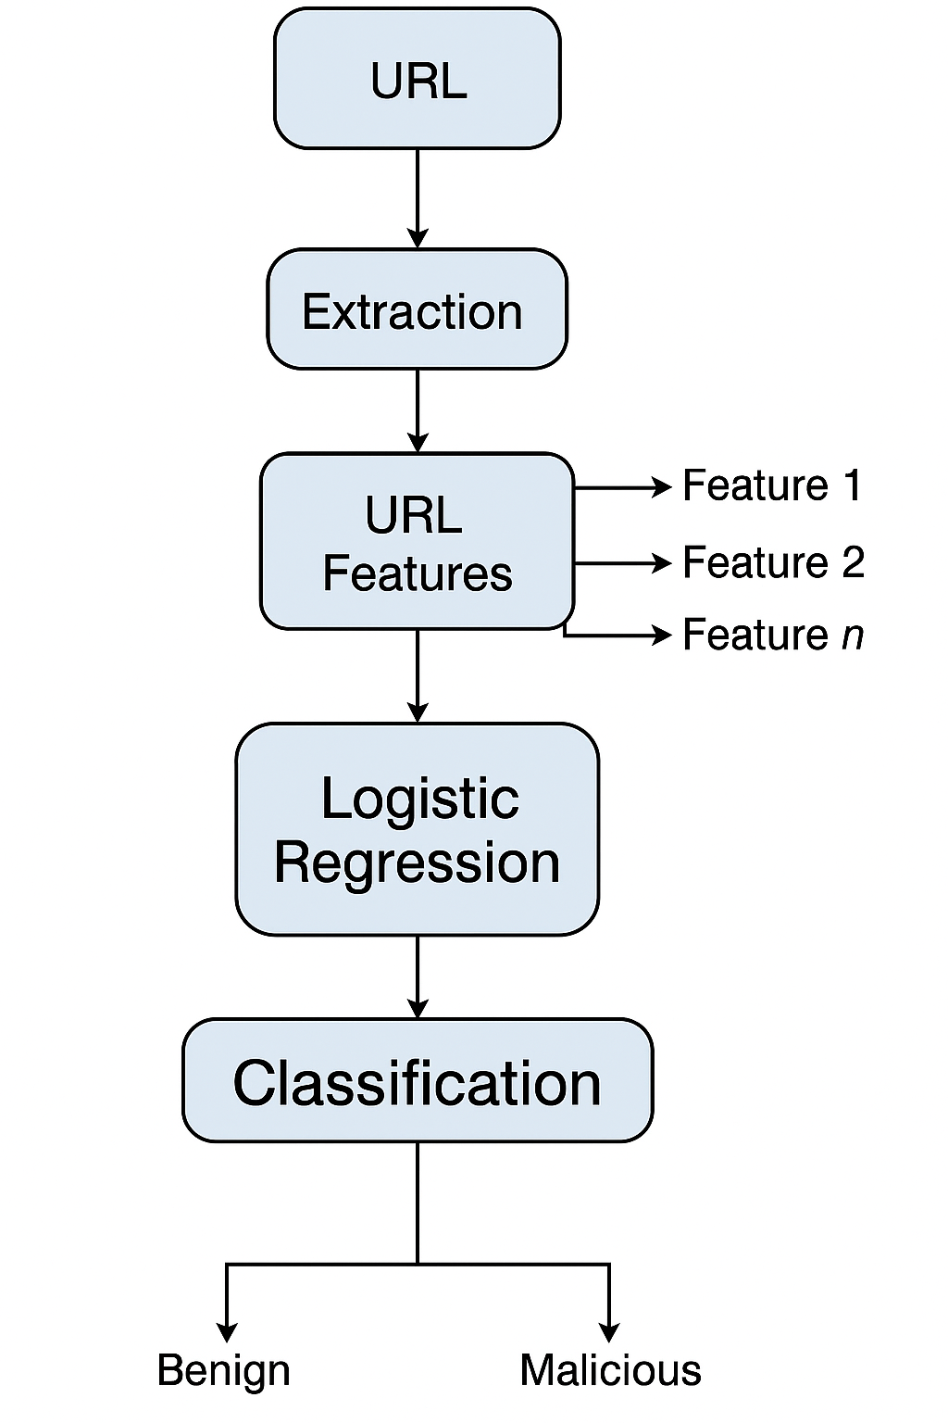
Machine Learning Methods
RandomForest - PE Analysis
Logistic Regression - Domain

Slide 10
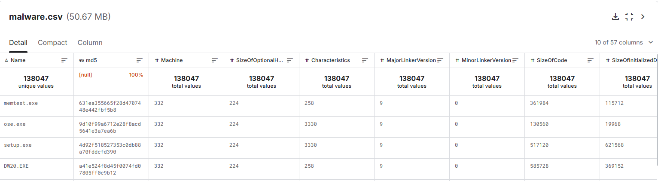
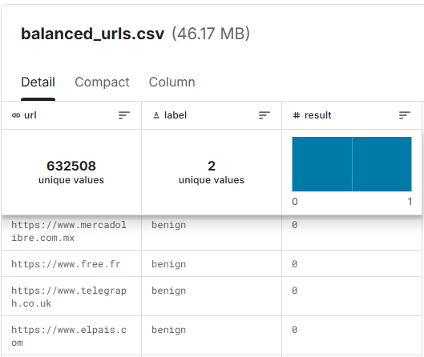
Machine Learning Data Sets
RandomForest - PE Analysis - Data
Logistic Regression - Domain - Data

Slide 11
Machine Learning Accuracy
RandomForest - PE Analysis - Data
Logistic Regression - Domain - Data
Dataset size → 10,000 PE files (5,000 malicious + 5,000 benign)
Test split → 20% test, 80% train
Random Forest performance on test set:
Accuracy → 95.8%
Precision → 94.6%
Recall → 93.2%
F1 Score → 93.9%
Dataset size → 84,093 URLs (phishing + benign)
Test split → 30% test, 70% train
Logistic Regression performance:
Accuracy → 98.57%
Precision → 98.11%
Recall → 99.60%
AUC Score → 0.9988

Slide 12
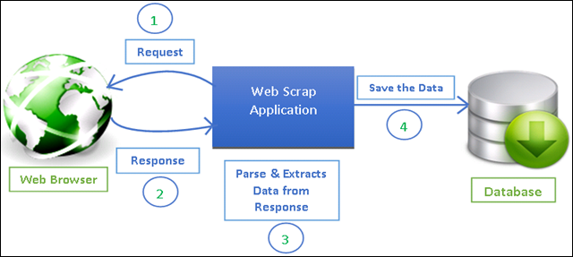
Scraper Architecture

Slide 13
Functional Design
OSINT-Based User Data Collection
Local scraping from public profiles (Instagram, Twitter, LinkedIn).
Collection of digital footprints (emails, usernames, bios).
Structured JSON formatting for collected data.
Privacy-safe, local execution of data collection scripts.
Password Generator
Personalized password creation using OSINT data.
Strong password criteria (length, complexity, randomness).
Local Large Language Model (LLM) for secure operation.
Internal password entropy and strength evaluation.
User-friendly interface providing clear strength indicators.
Backend API (Flask)
RESTful endpoints for each cyber security functionality.
Modular and scalable backend architecture.
Secure and efficient processing of user requests and data analysis.

Slide 14
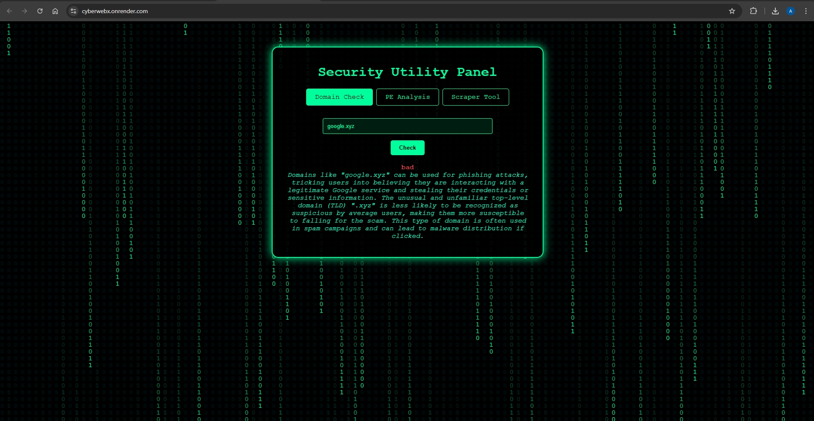
Web Design
URL - Domain Analysis

Slide 15
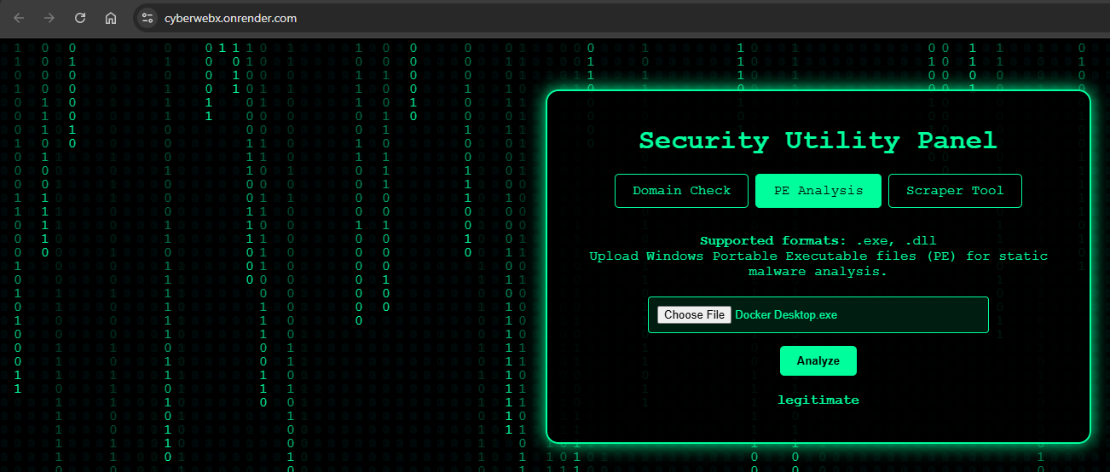
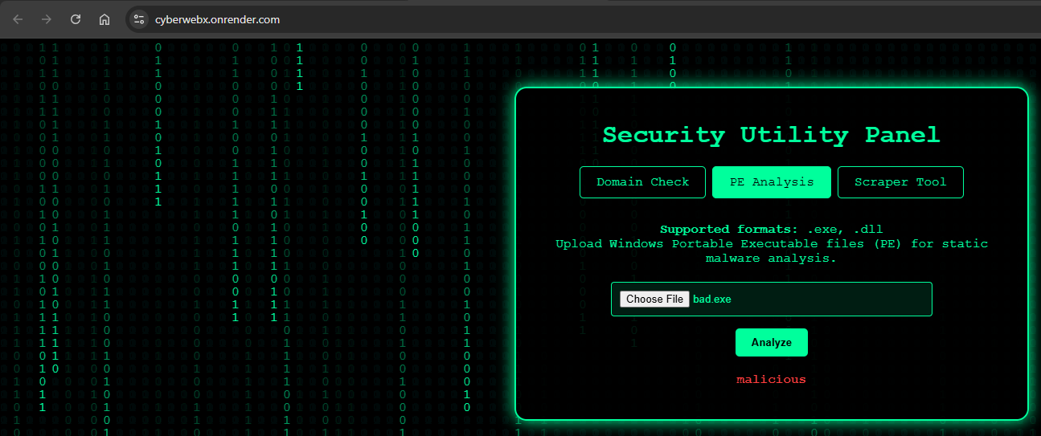
Web Design
Malware File Detection - PE Analysis

Slide 16
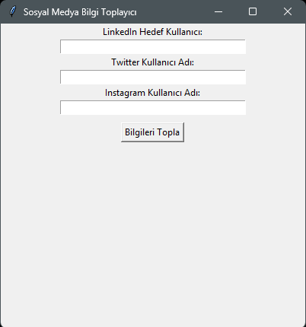
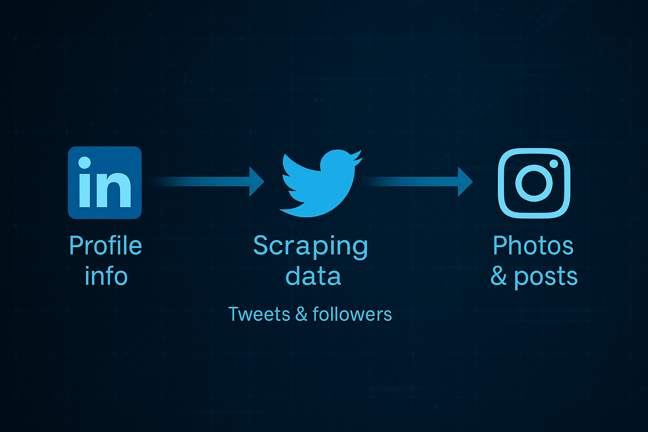
Web Design
Scrapper

Slide 17
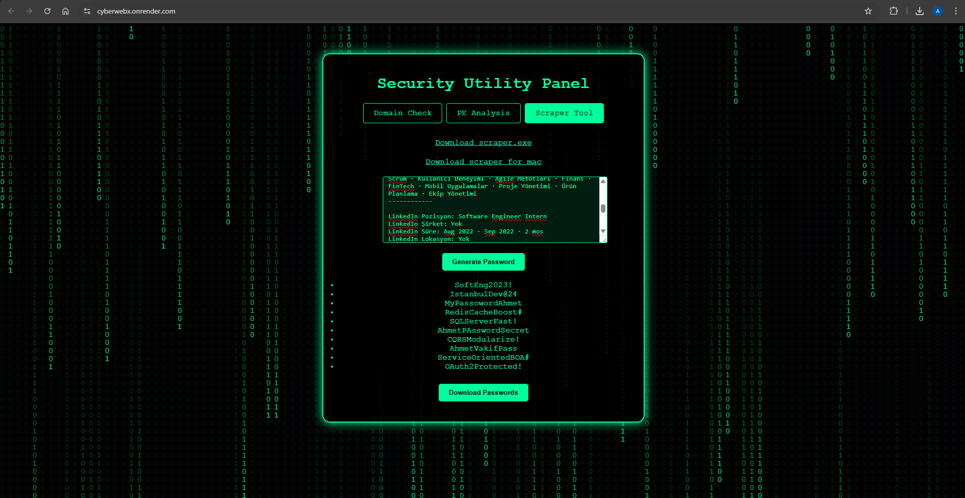
Web Design
Password Generator

Slide 18
Future Improvements
Dynamic Malware Analysis
Multi-platform Support
Integration of real-time behavioral analysis in sandbox environments.
Development of compatible mobile and desktop applications.
Real-Time Threat Feeds
Real-Time Notifications
Integration with WHOIS databases and DNS-based blacklists (DNSBL).
Instant alerts on threat detection (malware, phishing URLs, password breaches).
Enhanced User Authentication
Advanced OSINT Features
Implementation of JWT-based authentication and role-based authorization.
Expanded scraping capabilities for deeper user profiling.

Slide 19


